Slide 1

CUSTOMER PREDICTION
BA TECHNOLOGY, DATA, & INSIGHT
October 2022

Slide 2
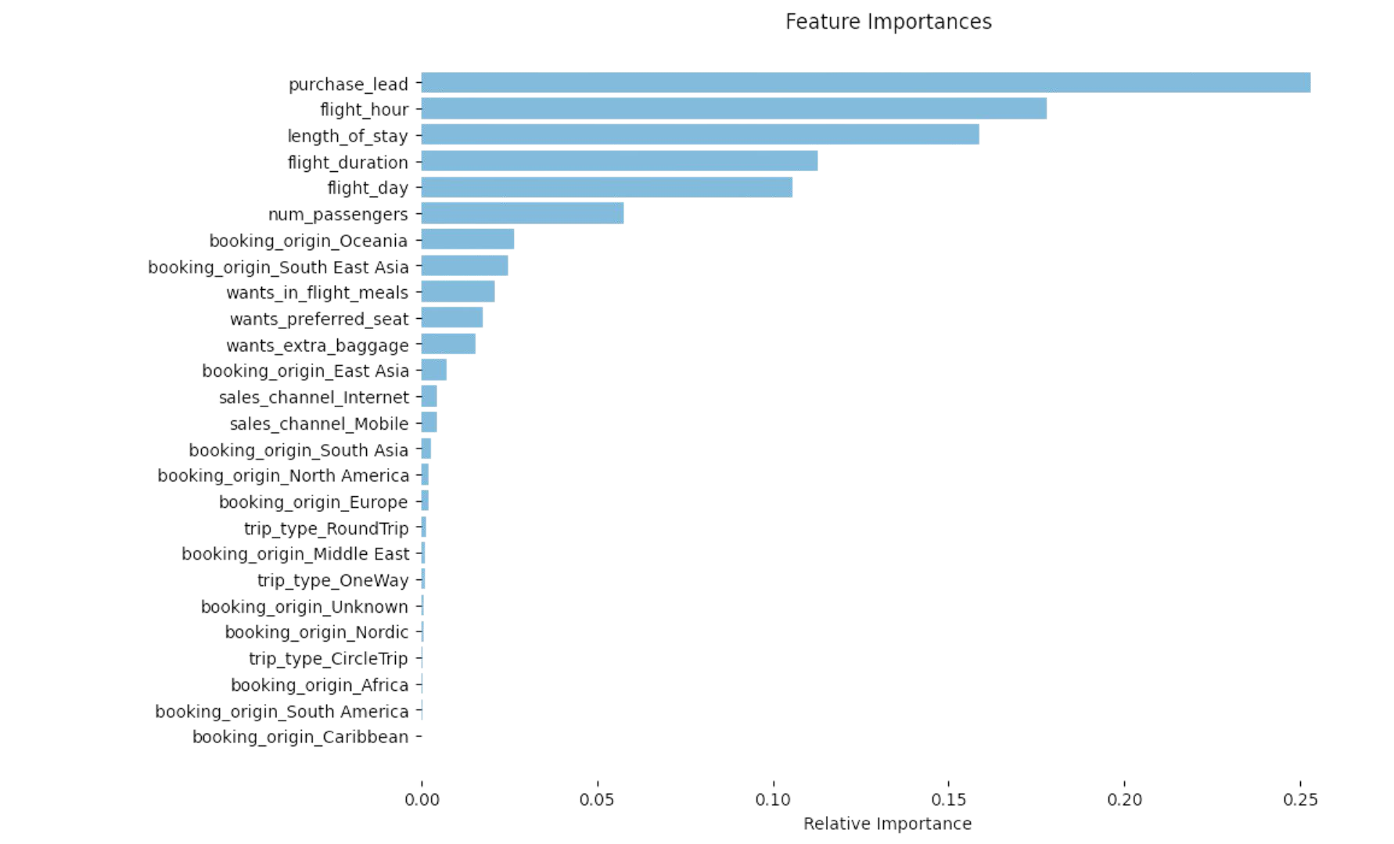
RESULTS
Evaluation
The most important variable in the model was purchase_lead, that is the time between purchase and departure.
Information about the flight, e.g. flight time and duration was also significant, however booking origin of the customer was not important.
The accuracy of the model was approximately 0.7 (Precision) and 0.003 (Recall), showing that this model requires more improvement. I suggest adding more customer-centric features into the model.
INFORMATION FOR BRITISH AIRWAYS INTERNAL USE ONLY
2

